Slide 1

The labyrinth of
ASL literature production
Dr. Mary Ann Seremeth
Notes:
https://www.youtube.com/watch?v=yOAmYSW3WyU

Slide 2
3 M’s:
ASL Literature Production
 | ASL | Literature | Production
Maintenance
Measurements
Mastery

Slide 3
Overview
1) to incorporate the values of video production structure and basic fundamental editing concepts to enhance ASL storytelling
2) to embrace the concept of multiculturalism and assess on how to bring multicultural aspects in ASL Literature video stories.
3) to gain cultural pride and positive self efficacy as a Deaf individual
Notes:
This presentation is based on 9 years of teaching ASL Literature Production.
The content of the presentation focuses on how this course provides students opportunities:

Slide 4
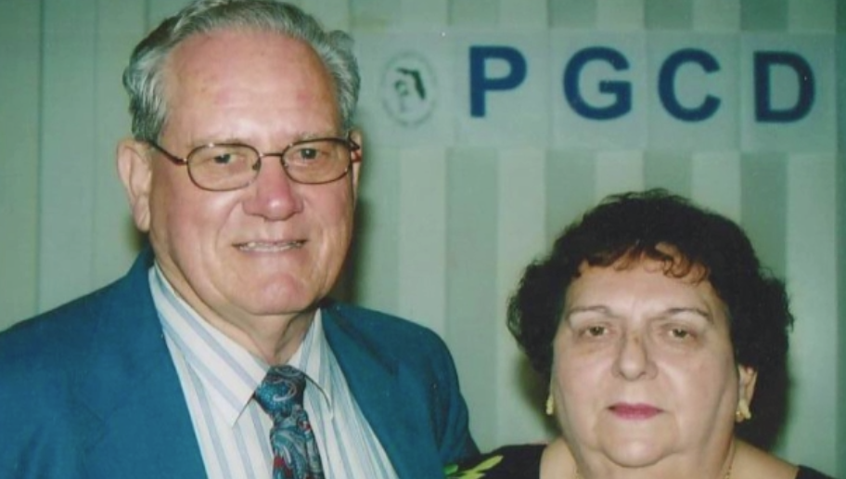
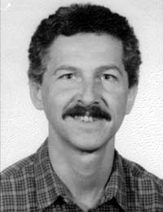
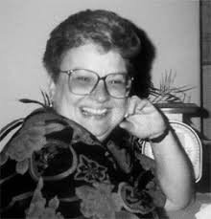
Foundations of
ASL Literature Production
Will & Dot Madsen
Dr. Clayton Valli
Marie Jean Philip
WHEN?
WHAT?
WHY?
HOW?
WHICH?
WHO?

Slide 5
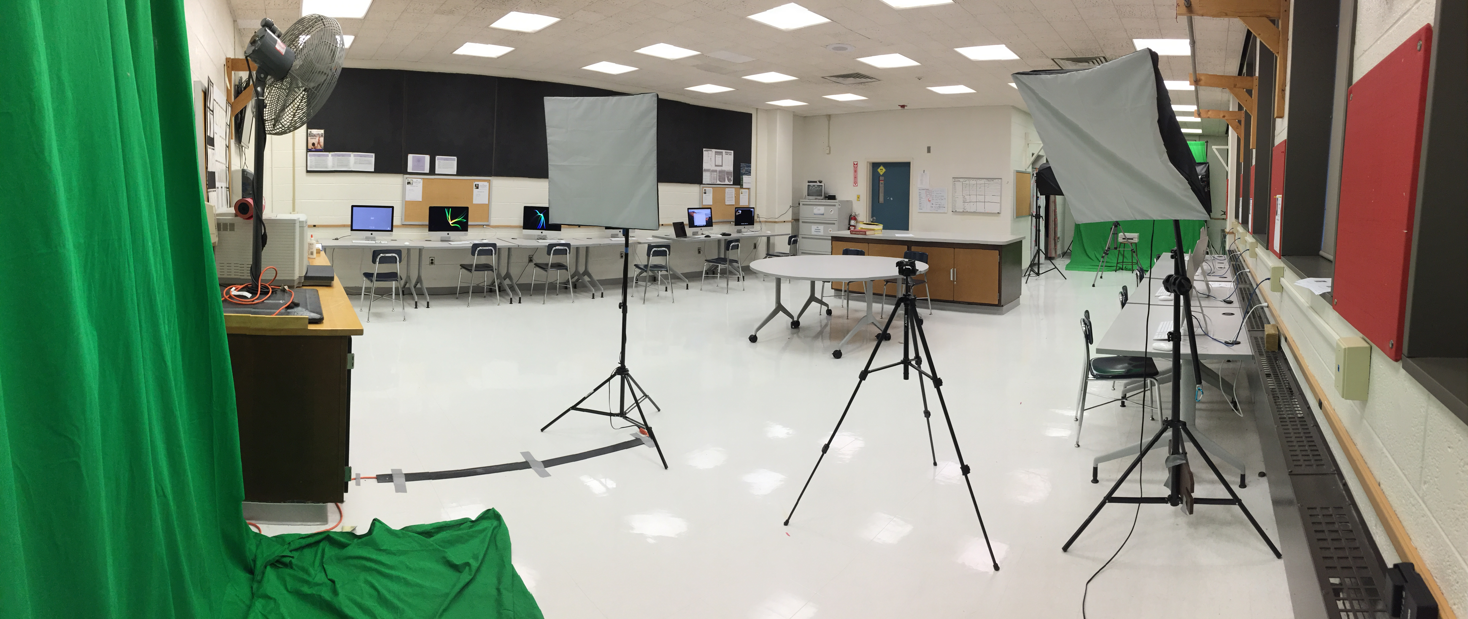
MacLab for
ASL Literature Production
Notes:
https://www.youtube.com/watch?v=yOAmYSW3WyU
http://aslchoice.com/language-assessment/#techniques
http://aslchoice.com/reep/

Slide 6
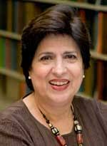
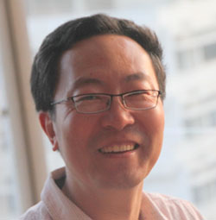

Translanguaging in Bilingual ASL-ENG
“Neither English nor Spanish is seen as static or dominant, but rather operates within a dynamic network of cultural and linguistic transformations.
“It is not two fixed identities or languages that are combined.”
“Translanguaging opens up the space to talk about this dynamic relationship, and to actualize it in the classroom.”
Notes:
García, O., & Wei, L. (2014). Translanguaging: language, bilingualism and education. Basingstoke: Palgrave Macmillan.
Ofelia García is Professor in the Ph.D. programs of Urban Education and of Hispanic and Luso-Brazilian Literatures and Languages at the Graduate Center of the City University of New York.
https://ofeliagarcia.org/
Li Wei is Professor of Applied Linguistics at the UCL Institute of Education, London. His research interests are in the broad field of bilingualism and multilingualism, including bilingual and multilingual first language acquisition, bilingual interaction, language maintenance and language shift in immigrant communities, family language policy, and bilingual and multilingual education.
https://www.birmingham.ac.uk/generic/tlang/project-team/li-wei.aspx
Li Wei is Professor of Applied Linguistics at the UCL Institute of Education, London. His research interests are in the broad field of bilingualism and multilingualism, including bilingual and multilingual first language acquisition, bilingual interaction, language maintenance and language shift in immigrant communities, family language policy, and bilingual and multilingual education.

Slide 7
Structure of ASL Literature Production
Introductory Unit:
Definitions of Literature
ASL Literature Genres
Video Production

Slide 8
Structure of ASL Literature Production
ASL Review/Critique Unit:
Introductory concepts on
review and critique of
ASL literature video stories
Genres of ASL literature video list
ASL literature review/critic worksheet form

Slide 9
Structure of ASL Literature Production
Video Project Units 1-5:
Unit 1
Student’s Autobiography
Unit 2
#2a: Famous Deaf Person Biography
#2b: an Interview with a Deaf Adult

Slide 10
Structure of ASL Literature Production
Video Project Units 1-5 (cont.):
Unit 3
#3a: Personal Lived Experience Story as
a Deaf Person
#3b: Short Story about Deaf Character(s)
Unit 4
#4a: ASL Poetry
#4b: Deaf Joke

Slide 11
Structure of ASL Literature Production
Video Project Units 1-5 (cont.):
Video Project Unit 5
#5(Fall): Halloween
#5(Spring): Public Service Announcement

Slide 12
An Example of Student’s work
Student’s video file was shown at the 2017 ASL Roundtable conference

Slide 13
5 Parameters of ASL
Handshapes
Numbers
Handshapes
Palm
Orientation
Movement
Non Manual Signals
Locations
Alphabet letters
Classifiers
Notes:
http://www.spreadthesign.com/us/12529/water-eau-american-english-french

Slide 14
5 Parameters of ASL
Handshapes
Palm
Orientation
Movement
Non Manual Signals
Locations
Upward
Downward
Turn right to left
Turn left to right
Notes:
http://www.spreadthesign.com/us/12529/water-eau-american-english-french

Slide 15
5 Parameters of ASL
Handshapes
Palm
Orientation
Movement
Non Manual Signals
Locations
Pacing:
Very fast
Fast
Average
Slow
Very slow
Directions:
(a to b)
hold-move (HM)
continuous
Shaky
Smooth
Bumpy
Notes:
http://www.spreadthesign.com/us/12529/water-eau-american-english-french

Slide 16
5 Parameters of ASL
Eyebrows:
Flat
Frown
Raised
Handshapes
Palm
Orientation
Movement
Non Manual Signals
Locations
Nose:
Twitching
Eye Pupil Directions
Nod
Tilt
Eyelid movements
Eyes
Head
Lips
Tongue
Teeth
Mouth
Sucked
Puffy
Cheek
Notes:
http://www.spreadthesign.com/us/12529/water-eau-american-english-french

Slide 17
5 Parameters of ASL
Head: Forehead
Chin
Cheeks
Nose
Upper Torso: Chest
Tummy
Shoulders
Handshapes
Palm
Orientation
Movement
Non Manual Signals
Locations
Arms:
Elbow
Wrist
Hand
Depiction:
Outward space from upper torso/head
Thigh/hip

Slide 18
Highlights of My Dissertation on Teacher Efficacy
Deaf teachers’ self-efficacy needs to be recognized as a strength within their instructional practice
The Bandura’s (1977) Self-Efficacy theory is focused on the individual’s perceived belief on the capabilities to follow through behaviors or action
Liu (2013) defined Teacher Efficacy by focusing on whether teachers can:
a) teach well
b) work through goals,
c) and help students succeed
Notes:
Seremeth, M. A. (2016). A study of teacher efficacy in secondary American Sign Language-English teaching
Self-Efficacy theory was a tenet of the Social Cognitive theory and the differences between “the source of judgments of efficacy and the level of the phenomenon being assessed” depends on how individuals judge their capabilities in a particular situation (Bandura, 2006, p.165).
“People judge their capacity for challenging activities more in terms of their perceptions of the knowledge, skills, and strategies they have at their command than solely in terms of how much they will exert themselves. Performances that call for ingenuity, resourcefulness, and adaptability depend more on adroit use of skills and specialized knowledge than on effort.” (Bandura, 1986, p.371)
Self- Efficacy: Self-efficacy is defined as expectations based on three dimensions of magnitude, generality, and strength impacting performance through accomplishments, vicarious experiences, verbal persuasion, and emotional arousal (Bandura, 1977).
Teacher-Efficacy: Teachers’ beliefs are based on their judgment toward their capabilities to engage students’ learning (Tschannen-Moran & Hoy, 2007).

Slide 19
Teacher Efficacy – ASL Teachers
TE#1: The Essence of Deaf Teachers
Definition: Innate ability to know what students and/or teachers lack and need in their environment

Slide 20
Weak
Moderate
Strong
1) Cultural Navigation | The ability to transcend and have a heightened awareness for cultural boundaries
2) Self-Reflective Talk | The ability to analyze about self
3) Mentoring Others | The ability to share advices on context, process, and strategies
4) Mentored By Others | The ability to receive feedback and wisdom
5) Recognition of Personal Knowledge | The way of authenticity in accepting students’ knowledge or lack of knowledge.

Slide 21
Teacher Efficacy – ASL Teachers
TE#2: An Insight of Anticipation of Mutual Dialogue
Definition: To know what students need and how students think and learn things by teacher’s anticipation, and facilitating appropriate cultural discourse

Slide 22
Weak
Moderate
Strong
1) Ask and Empower | The ability to request feedback and figure out what students need in order to understand better
2) Interact and Making Solid Connections | The ability to offer explanations on the basis of individual and personal decisions
3) Expect the Unexpected | The ability to be present with students and handle the unanticipated incidents from students’ learning experiences

Slide 23
Teacher Efficacy – ASL Teachers
TE#3: Teaching Reciprocity
Definition: Mutual dialogue and exchange of knowledge between teachers, students, and members of the community

Slide 24
Weak
Moderate
Strong
1) Involve Students to Support Community | The choice in gaining a meaningful position in the community
2) Teacher Supports the Community | The participation in the community is the key to learning-based events
3) Parents-Teachers Interaction | The dialogue and communication between parents and teachers to build connections

Slide 25
Teacher Efficacy – ASL Teachers
TE#4: Alternative Electronic Media
Learning Tools
Definition: Teacher-created or generated media resources

Slide 26
Weak
Moderate
Strong
1) Teacher-created Media Resources | Resources which teachers create on their own
2) Teacher-used Media Resources | Electronic- generated resources which teachers use in teaching

Slide 27
Teacher Efficacy – ASL Teachers
TE#5: The Depth of Identity Through
Bilingual ASL-English
Definition: Capture the message of innate knowing of circumstances where teachers know when to use ASL/English to communicate.

Slide 28
Weak
Moderate
Strong
1) Insightful Responsive Teaching | To know when the spark of connection occurs between teaching and learning
2) Ability to be Flexible | To modify instruction for clarity of both teacher and students’ linguistic/ academic understanding
3) Influential Decision | Weighing the balance of what is right and what is required to teach

Slide 29
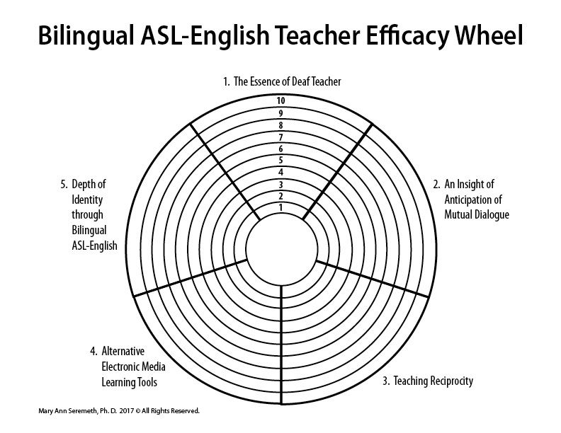
A Self-Reflection Tool
Notes:
A teacher can fill out this self-reflection Bilingual ASL-English Teacher Efficacy Wheel periodically to assess what she or he needs to work on or evaluate how she or he is doing. Contact Dr. Seremeth at mseremeth@gmail.com for life coaching in regards to teacher coaching. She is a certified life coach.

Slide 30
Multicultural Transformation Education
1. Teachers for Social Justice: Deaf Learners
(one-week retreat)
2. Multicultural Curriculum Transformation Institute
(training)
3. Personal and Professional Development
(allyship with Deaf People of Color &
marginalized Deaf people)

Slide 31
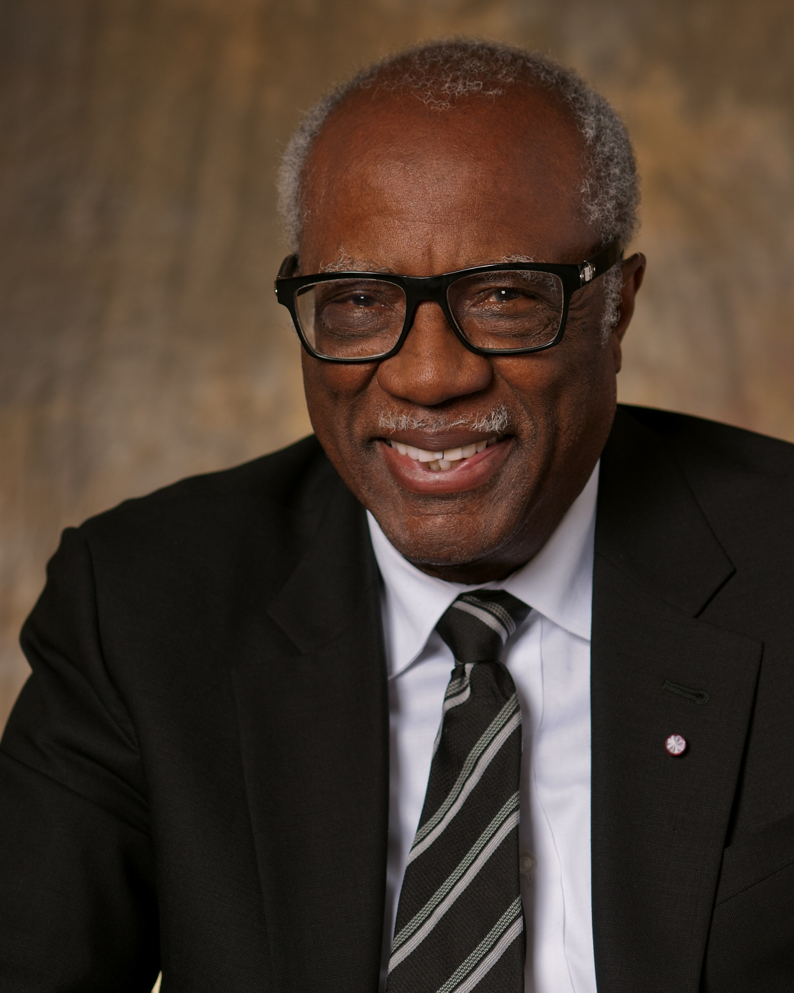
Levels of Integration of Multicultural Content by James A. Banks
Level 4 The Social Action Approach:
Students are empowered to become reflective social critics and skilled participants in social change with support from school teachers and staff
Level 3 The Transformation Approach:
The structure of the curriculum is changed with an intention to include multiple perspectives from diverse ethnic and cultural groups (concepts, issues, events, and themes)
Level 2 The Additive Approach:
Content, concepts, themes, and perspectives are added to curriculum without changing its structure.
Level 1 The Contributions Approach:
Focuses on ethnic content for to special days (heroes, holidays, and discrete cultural elements
Notes:
http://resources.css.edu/diversityservices/docs/levelsofintegrationofmulticulturalcontent.pdf
https://faculty.washington.edu/jbanks/
Multicultural education theorists are increasingly interested in how the interaction of race, class, and gender influences education (Banks, 1989a; Grant & Sleeter, 1986; Sleeter, 1991).

Slide 32
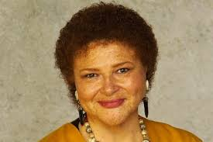

Language Codes
“Students must be taught the codes needed to participate fully in the mainstream of American life”
“that they must be allowed the resource of the teacher’s expert knowledge, while being helped to acknowledge their own “expertness” as well;”
“and that even while students are assisted in learning the culture of power, they must also be helped to learn about the arbitrariness of those codes and about the power relationships they represent.”
Notes:
Delpit, L. D. (1995). Other people's children: cultural conflict in the classroom. New York: New Press.
“To summarize, I suggest that students must be taught the codes needed to participate fully in the mainstream of American life, not by being forced to attend to hollow, inane, decontextualized subskills, but rather within the context of meaningful communicative endeavors; that they must be allowed the resource of the teacher’s expert knowledge, while being helped to acknowledge their own “expertness” as well; and that even while students are assisted in learning the culture of power, they must also be helped to learn about the arbitrariness of those codes and about the power relationships they represent.” (Delpit, 1995, p. 45)

Slide 33
An Example of Student’s work
Student’s video file was shown at the 2017 ASL Roundtable conference
Notes:
Delpit, L. D. (1995). Other people's children: cultural conflict in the classroom. New York: New Press.
“To summarize, I suggest that students must be taught the codes needed to participate fully in the mainstream of American life, not by being forced to attend to hollow, inane, decontextualized subskills, but rather within the context of meaningful communicative endeavors; that they must be allowed the resource of the teacher’s expert knowledge, while being helped to acknowledge their own “expertness” as well; and that even while students are assisted in learning the culture of power, they must also be helped to learn about the arbitrariness of those codes and about the power relationships they represent.” (Delpit, 1995, p. 45)

Slide 34
3 M’s:
ASL, Literature, and Production
 | ASL | Literature | Production
Maintenance | Showcase Classroom Schoolwide Peer teachers | Understanding of a spiral curriculum: Genres Videos | Keep with the latest trends of video applications, video cameras, computers, and labs
Measurements | Rubrics Checklist of skills Step-by-step chart | Applications of the criteria and appropriate cultural usages | Completion of video production: a) video clips b) Video file storage
Mastery | Linguistic fluency: to talk in explicitly, and semantically dense sentences; to converse in different contexts; and to be creative in the language. | Creation, Knowledge, and Analysis of different genres | Application of production skills through different applications, equipment and platforms
Notes:
Discourse ( Registers, order of information, purpose)
https://watermark.silverchair.com/3-4-320.pdf?token=AQECAHi208BE49Ooan9kkhW_Ercy7Dm3ZL_9Cf3qfKAc485ysgAAAbYwggGyBgkqhkiG9w0BBwagggGjMIIBnwIBADCCAZgGCSqGSIb3DQEHATAeBglghkgBZQMEAS4wEQQMOUAfpl0hEfO2S7RpAgEQgIIBaSZdAHY50fUPVe0_jYVpQRcUjFwEVzWxowGeIrmTEM7t9m8S4nfiQgVGUM2c6RWsgUUKV0I3wfVxNird2XE1_YgdovwtULArn6SZNtTJMiLg4aNK-WbRebU48WwzZ1nYLG1vwihggkaFilHQHvT_S2Eg72hYiCnphmbBcbt-GtMDkgQR42qNz2Q0zuAV8LSHk799ZmIgApcmNKDu3K_xwjRmuvPzHljR4YXzujmxuvKQrCUh8wqkbAs2Qcc5uh4TklbZRBrfMthva3w_E2Wgqce-v5EK-qCKEYlMs200YyCAenKZCcVa8PW0dxeHZDYH2zNd3jLwrrwrZb47njsXiuNf-phiK37m0LUatlu6rBpMkhS5_IHqPeFI36VbHh75L7TqORl6l4KQyQMKWcKbJm81vYk4i1uy6nbVCs1_HWE2rnffBPYfSs8j42BzHi9W9PiANW2YHQ6ffhzHQYGF533yWLi1EFjjlXQ

Slide 35

A quote to remember
Each step
we consciously take
will move us forward!

Slide 36
REFERENCES
Banks, J. (1996). Multicultural education, transformative knowledge, and action: Historical and contemporary perspectives. New York, NY: Teachers College Press.
Delpit, L. D. (2006). Other people's children: cultural conflict in the classroom. New York: New Press.
García, O., & Wei, L. (2014). Translanguaging: language, bilingualism and education. Basingstoke: Palgrave Macmillan.
Seremeth, M. A. (2016). A study of teacher efficacy in secondary American Sign Language-English teaching (Order No. 10254440). Available from ProQuest Dissertations & Theses Global. (1870036812). Retrieved from http://proxyga.wrlc.org/login?url=https://search-proquestcom.proxyga.wrlc.org/docview/1870036812?accountid=27346

Slide 37
Dr. Mary Ann Seremeth’s Contact information
Work email:
mary.seremeth@gallaudet.edu
3L MAS Life coach email:
mseremeth@gmail.com

