Slide 1
ASL Specialist’s palette
Petra M. horn-marsh, PhD
Kester horn-marsh, ma
Aslrt 2017, Indiana school for the deaf
Measurement, maintenance, Mastery

Slide 2
Why an ASL Specialist's palette?
IEP meetings:
Educating parents new to ASL or resistant to the benefits and opportunities in bilingual schools
Educating LEAs about students’ true needs: language, LRE, and critical mass
Outreach assessments and training:
Assessing non-KSD students
Training public school administrators, special education coordinators, special education directors, TODs and interpreters
Our palette:
Offering visuals and anecdotes that are easily ACCESSIBLE and easily UNDERSTOOD

Slide 3
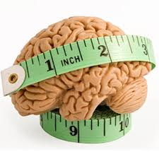
A Palette on Measurement

Slide 4
Provide physical evidence of your assessments
Kendall Conversational Proficiency Levels:
Highlight milestones
Use graphics
Make available to parents and LEAs when giving your reports
Notes:
Created in Microsoft Publisher.

Slide 5
Provide physical evidence of your assessments
Visual Listening Assessment Tool:
Highlight how data is used
Use graphics
Make available to parents and LEAs when giving your reports
Notes:
Created in Microsoft Publisher.

Slide 6
THIS IS YOUR STUDENT’S BRAIN:

Slide 7
This is your student’s brain on drugs:

Slide 8
This is your student’s brain on…
Two or more languages:
One language:

Slide 9
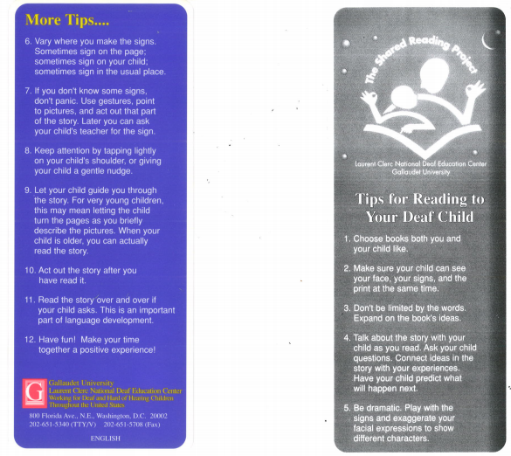
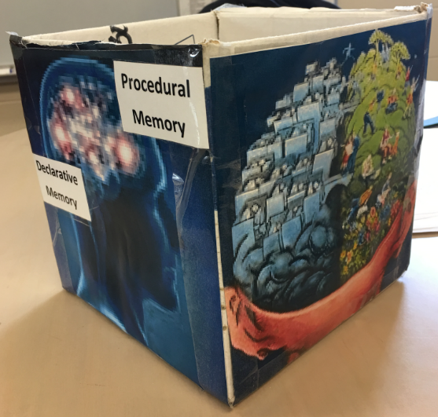
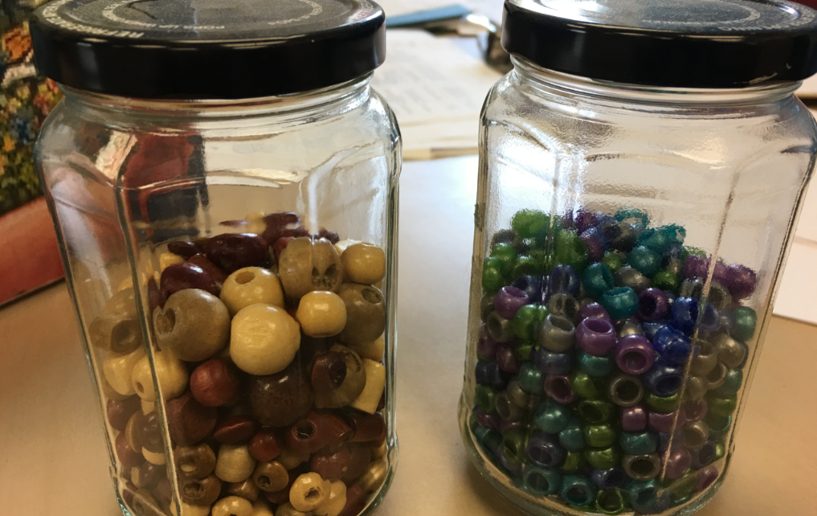
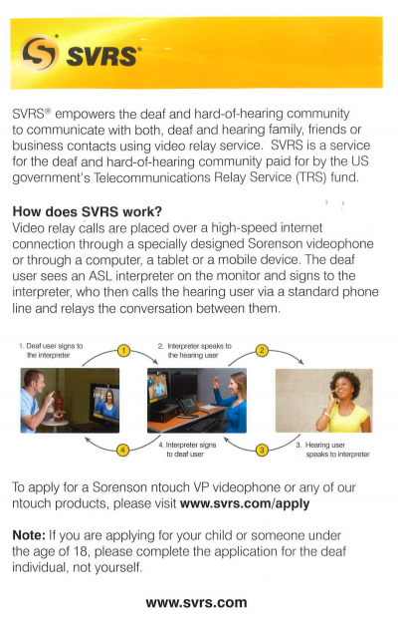
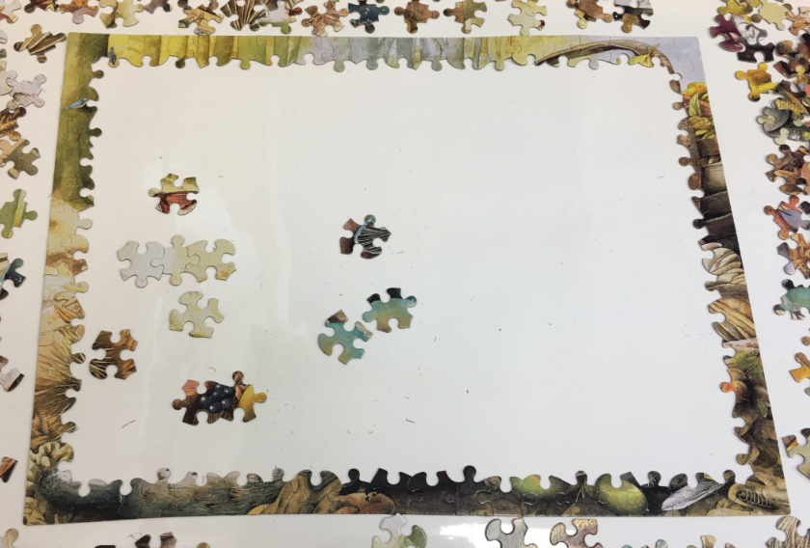
Use of props during reports or presentations
Notes:
Model the box and the cups of water.

Slide 10
Show ASL Comprehension
25% comprehension
Notes:
Taken from an audiologist’s palette.

Slide 11
Show ASL Comprehension
50% comprehension
Notes:
Use this with receptive ASL skills reporting.

Slide 12
Show ASL Comprehension
75% comprehension

Slide 13
Show ASL Comprehension
100% comprehension

Slide 14
Show Importance of Early Fluent language exposure
Berk, L. E. (2014). Development through the lifespan, (6th ed.).Boston, MA: Pearson Education, Inc. ©2016, Office of Deaf Services.
Notes:
When a Deaf child is born to hearing parents, they typically don’t know what to do nor how to communicate with their child. As a result, the family in crisis usually defaults to what is “normal” for them…talking (which often results in NO language exposure during this critical stage).
What this often means is a significant (a year or more) delay in language exposure and growth within areas of the brain. It is significantly harder to develop language after the opportunity for language growth slows.

Slide 15
Use of Data from Your School: Making Data Visual (A Demonstration)
2016-17 Demographics of KSD STUDENTS:
Total Population = 114
Total Number of Students Tested = 58 (51%)
Students not Tested = below age 9, D++, or arrived KSD at P-Level 7 at age 17+
Age Range = 8 years to 19 years old
Students With Deaf Parents = 18
Students With Hearing Parents = 40
Horn-Marsh, K., 2017
Notes:
D++ means DHH kids with additional disabilities which cognitively affect language acquisition and learning.

Slide 16
Use of Data from Your School: Impact of Early Language Access on Conversational Proficiency
N=18
N=40
Horn-Marsh, K., 2017
Notes:
Early Access = DHH parents (78% of students achieve typical language acquisition)
Late access = hearing parents (22% achieve typical language acquisition)

Slide 17
Use of Data from Your School: Students With Hearing Parents Who Achieved Level 6 by Age 9
at KSD
at KSD
N = 9
N = 1
N = 8
N = 2
Horn-Marsh, K., 2017
Notes:
22% who are on level, but have hearing parents:
90% have hearing parents who sign.
80% attended ECC or Kindergarten at KSD.

Slide 18
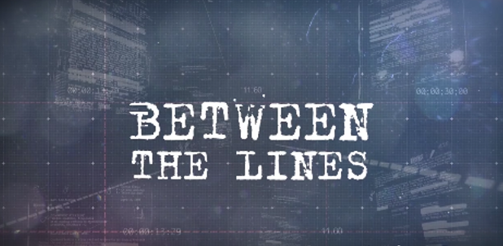
Use videos
Defining Language Deprivation
https://www.facebook.com/BetweenTheLinesDPAN/
Notes:
Click on the link above.

Slide 19
Show Other Videos: Language deprivation
https://m.youtube.com/watch?feature=youtu.be&v=cUTymzn5FEc

Slide 20
Tap on The Power of Using quotes
"The human brain does not discriminate between the hands and the tongue. People discriminate, but not our biological human brain."
Dr. Laura-Ann Petitto (VL2 Project)
Notes:
This is the most current and ongoing brain research in the country not tied to a medical facility.

Slide 21
“Language delays are never a result of deafness, but a child’s lack of full, direct, and meaningful access to ASL and English.”
James E. Tucker
The Maryland Bulletin, Fall 2014
Notes:
TODs, SLPs, and psychologists typically say, “Because of the child’s deafness or hearing impairment…”

Slide 22
“Why is it considered abuse when a hearing child is discovered with no language by the age of 3, yet normal for a deaf child to have little or no language by the age of 3?”
Dr. Sanjay Gulati:
(2014 presentation at the Boston Children’s Hospital
Notes:
After reading Wikipedia’s definition of language deprivation.

Slide 23
Use current publications
When students do not get the basic building blocks, they don’t feel safe
Providing children appropriate language opportunities gives them a feeling of safety
Children can then progress through the hierarchy
Notes:
When students do not have early fluent and meaningful communication, they do not feel safe. That impedes movement up the hierarchy.

Slide 24
Use current publications
Visual split attention causes increased cognitive load
When students receive an education through an interpreter, it requires more work than if it was through direct instruction in ASL
Notes:
Use this to argue against using an interpreter vs being in a bilingual environment with critical mass.

Slide 25
The Palette of Allegories, Comparisons & Examples
The Case of Dichotomous Confusion

Slide 26
Plato’s Cave Allegory
400 BC – Plato: “Deaf people cannot speak; therefore Deaf people lack intelligence.” www.emaze.com
360 BC - Socrates claims that Deaf people are incapable of language and ideas.
www.ead.ee/foreign_deaf_history
355 BC - Aristotle says "Those who are born deaf all become senseless and incapable of reason.” www.ead.ee/foreign_deaf_history
Notes:
This shows an education through an interpreter vs direct access to education. Two percent (2%) of the world’s Deaf population has access to education in sign language. [2]
Plato proposed a theory that if prisoners in a cave were not allowed to see anything except shadows on a wall, created by puppeteers, they would think that the puppets they saw were real.
If they escaped, they would see the true form of reality illuminated by the sun. They would truly be free.
I’d like to take it a step further. How does this apply to you today? I want you to think of the education you’ve had compared to other Deaf people. You had direct access to your peers, your teachers, and the curriculum. You perceive reality in its true form. Your minds are free.
Many Deaf kids don’t have direct access to their education or to the world around them. They have incomplete access through only one language, through technology alone, or through an interpreter. Are they seeing the real thing, or are they seeing shadows made by puppeteers?

Slide 27
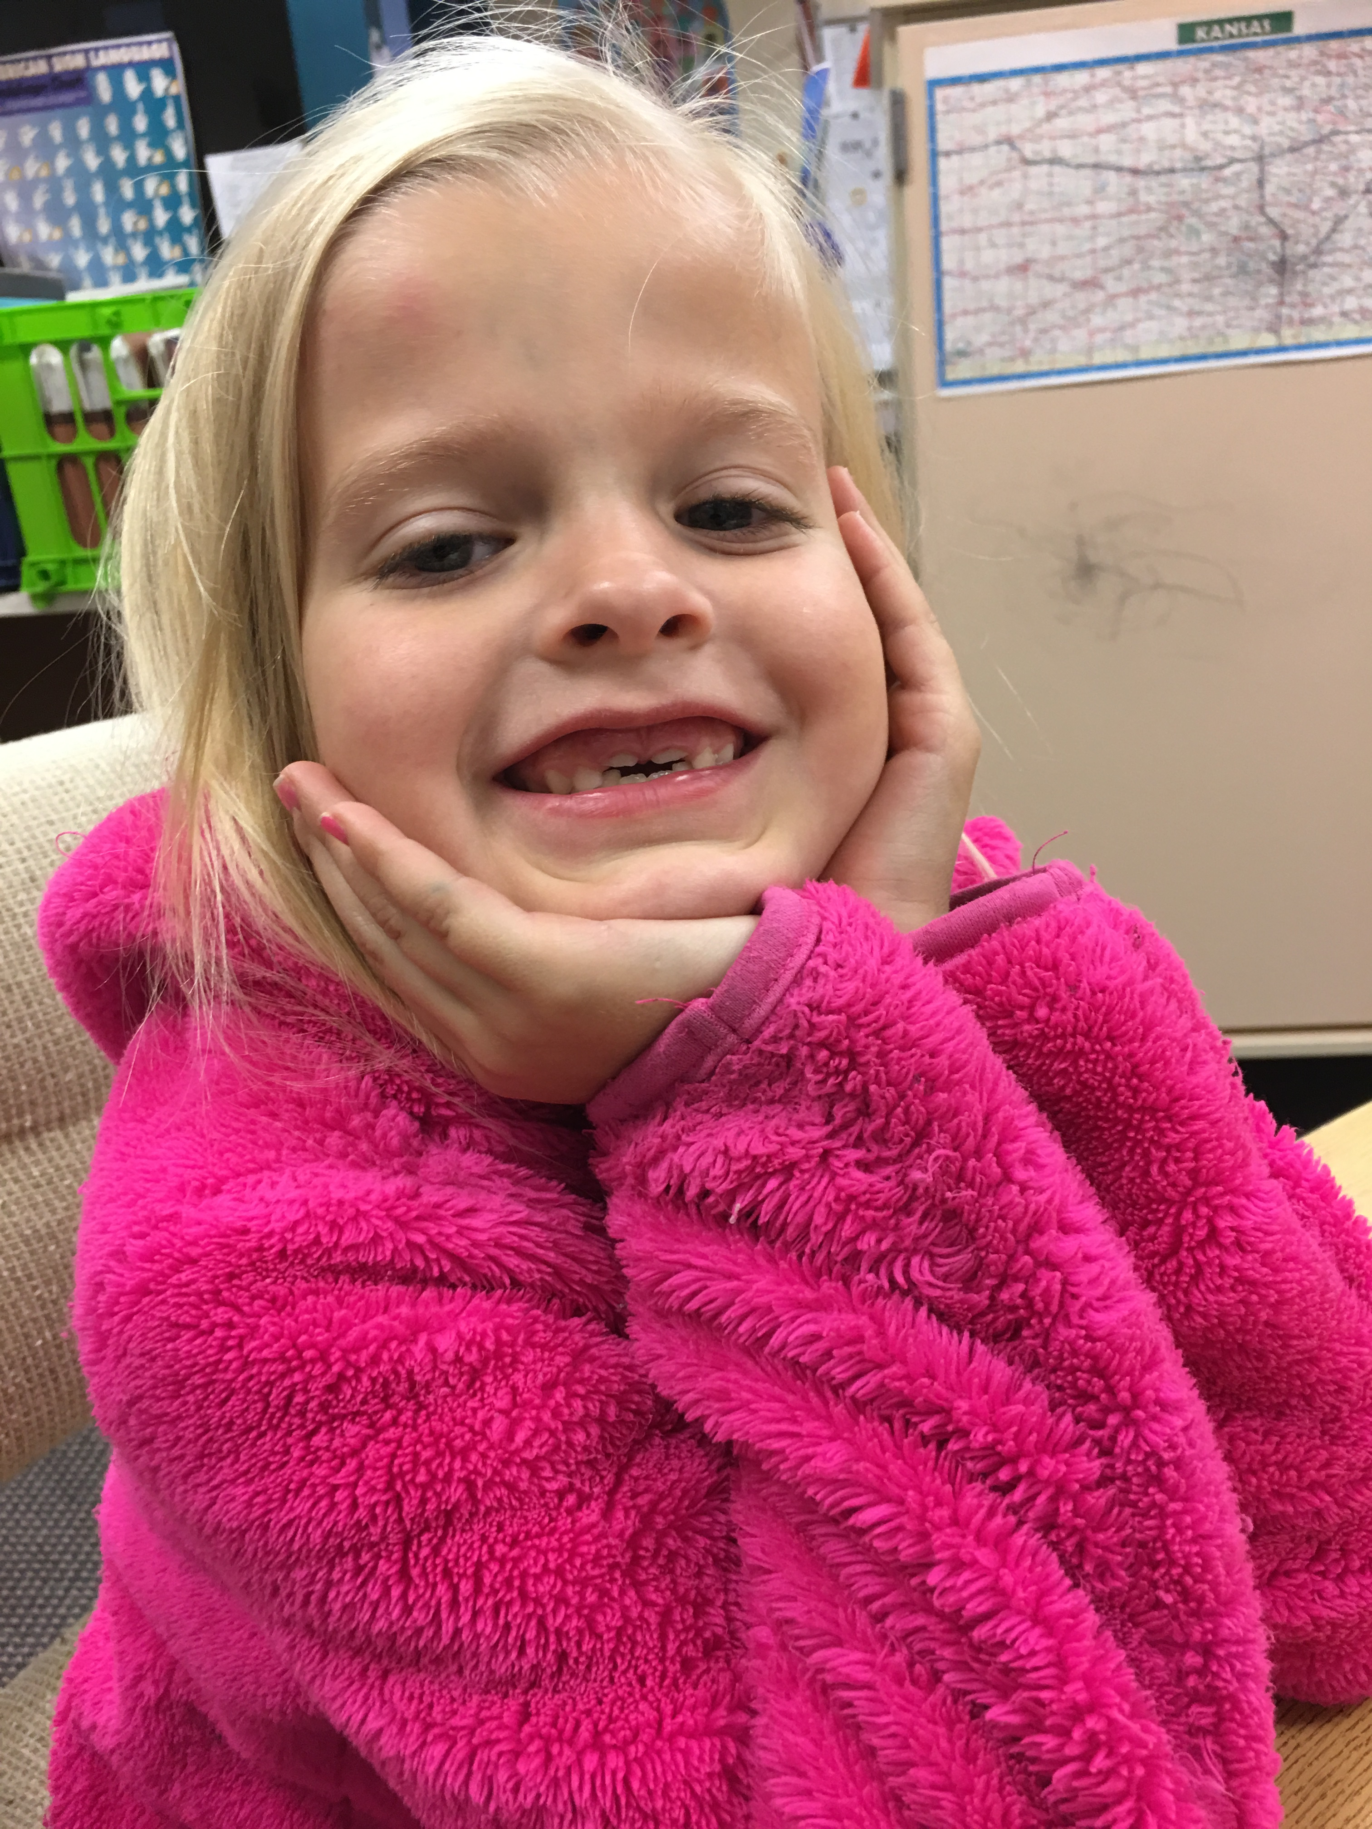
Deaf child age 5.11
Deaf parents who used ASL since birth
Deaf older brother with Autism
Mainstream program with interpreter until 1st Grade
P-Level 1.5 in Kindergarten
Why is her P-Level so low?
Notes:
Obstacles include no critical mass of peers, few, weak adult language models, and no direct access to communication, her peers, her teachers, and the curriculum
Remove the obstacles to see growth

Slide 28
Another analogy
Young trees need water, sunlight, and room to grow
The older trees are overcrowding the younger trees, stunting their growth
Older trees = older, auditory-based approaches
Remove some of the obstacles (thin out the older trees) to give the younger trees room to grow

Slide 29
Harry potter:
“Regular” society views him as an outcast
Has special, untrained, sometimes unknown “abilities”
Fits in better at a “special” school
Identifies better with similar children
Receives specific training to develop “special abilities”
Learns to successfully negotiate two worlds
Contributes to the next generation

Slide 30
Deaf child:
“Regular” society views him as an outcast
Has special, untrained, sometimes unknown “abilities”
Fits in better at a “special” school
Identifies better with similar children
Receives specific training to develop “special abilities”
Learns to successfully negotiate two worlds
Contributes to the next generation
Notes:
This is a child assessed through the KSD Outreach Team. I described an analogy comparing this child to Harry Potter. I claimed that all this child needed was to tap into another language, ASL, and that he needed to do it among other children like himself to unlock hidden abilities.

Slide 31
Dichotomous Comparison
We must fight sound deprivation!
We must fight language deprivation!

Slide 32
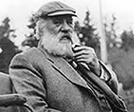
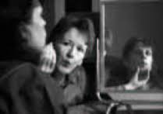
Smoke and Mirrors
“We should try to teach them to forget that they are deaf.”
Notes:
Illusion

Slide 33
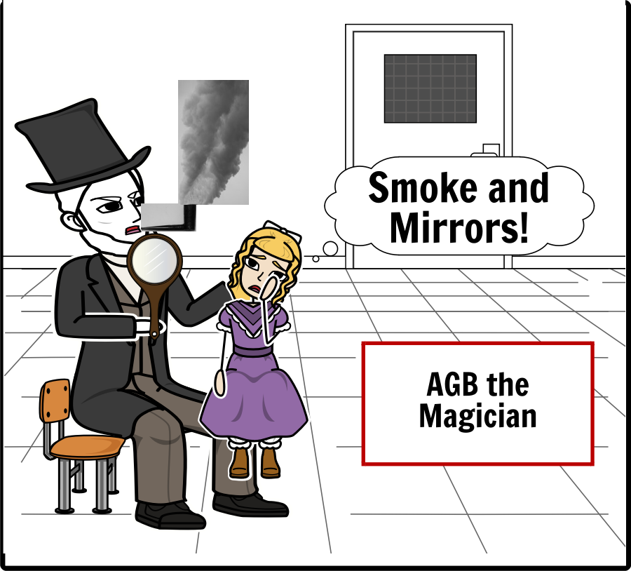
Notes:
Made from the Storyboard That! App.

Slide 34
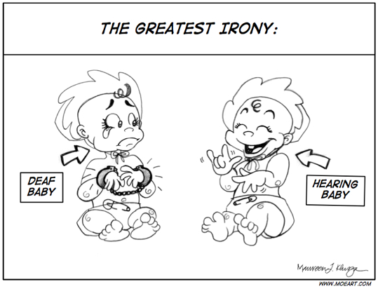
The Art of
Presenting & Explaining

Slide 35
Language deprivation
* Withholding language opportunities can be seen as a form of abuse

Slide 36
Comprehensible input?
Krashen Questions:
Is the language used with the child comprehensible?
Is the sign language used by the adult at the appropriate level?
If not, more than likely, a lot of the information being input is escaping and not being absorbed.
Quick fixes or patches do not work in the long run.
Replace the old, broken pipe with completely new pipe = new delivery approach.

Slide 37
When Talking about Students’ ASL Proficiency
Use the word:
Use the word:
MEANINGFUL
VS
IDEAL
OPPORTUNITIES
VS
CHOICES

Slide 38
Opportunity missed? Or…

Slide 39
Opportunity taken!
Notes:
Leo and Eli are Kindergarteners who are Kindergarten ready.
Typically only 5 to 10% of all Deaf kids in the state of Kansas are Kindergarten ready.
Most of those kids come from families where both parents are Deaf.
These parents are hearing. Their daughters are hearing.
Leo and Eli came to America 19 months ago with NO LANGUAGE.
Kindergarten ready in 19 months! How is this possible? The entire family signed to them and read books to them.
Leo and Eli had continual access to ASL AND English. There’s no OR here.
ASL AND English.
Resource: “Signs For Me”

Slide 40
Presentation of Examples: Level 3 Certified Educational Interpreters Translate at or Below 60% of the Original Information in the Classroom!
The Illusion of Inclusion
Level 3: Intermediate: Demonstrates knowledge of basic vocabulary, but may lack vocabulary for more technical, complex, or academic topics……An individual at this level would be able to communicate very basic classroom content but may incorrectly interpret complex information resulting in a message that is not always very clear.*
*Schick, B, Williams, K & Kupermintz (2006). Look Who’s Being Left Behind: Educational Interpreters and Access to Education for Deaf and Hard of Hearing Students. Journal of Deaf Studies and Deaf Education 11:1, page 18.

Slide 41
An Example of ASL Deprivation and Delay, and Student Learning
6th Grade Deaf Child has only 2nd Grade ASL Comprehension Skills
6th Grade Social STudies Content Using 6th Grade ASL Vocabulary
?
It is impossible for a classroom teacher in any language to adapt the level of language and vocabulary use more than two grade levels.
* If a child is put in this situation, s/he is not comprehending the teacher, his/her peers, and the curriculum.

Slide 42
Another Example of ASL Deprivation and Delay, and Student Learning
6th Grade Deaf Child has only 2nd Grade ASL Comprehension Skills
6th Grade Science Content Using 6th Grade ASL Vocabulary
?
* Providing an education in ASL in the classroom for a child who lacks social or academic proficiency in ASL is the equivalent of providing an education in Chinese for the child who does not have age-appropriate and grade-level Chinese language.

Slide 43
A Palette of Maintenance
Notes:
TV show based on triage: treating soldiers so they can get back to the war.

Slide 44
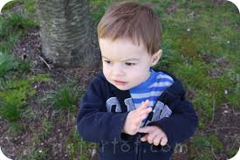
Miracle ASL Staff Hands
M*A*S*H
Notes:
Saving students’ lives by providing language and communication.

Slide 45
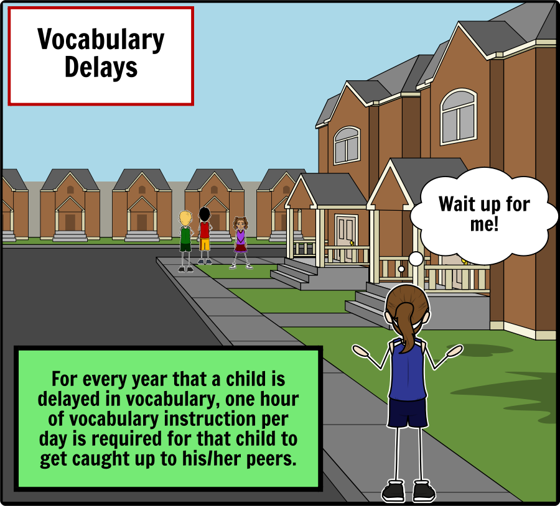
Notes:
Yes we do teach transitions, CLs, NMMs, etc. Robust vocabulary development is needed.

Slide 46
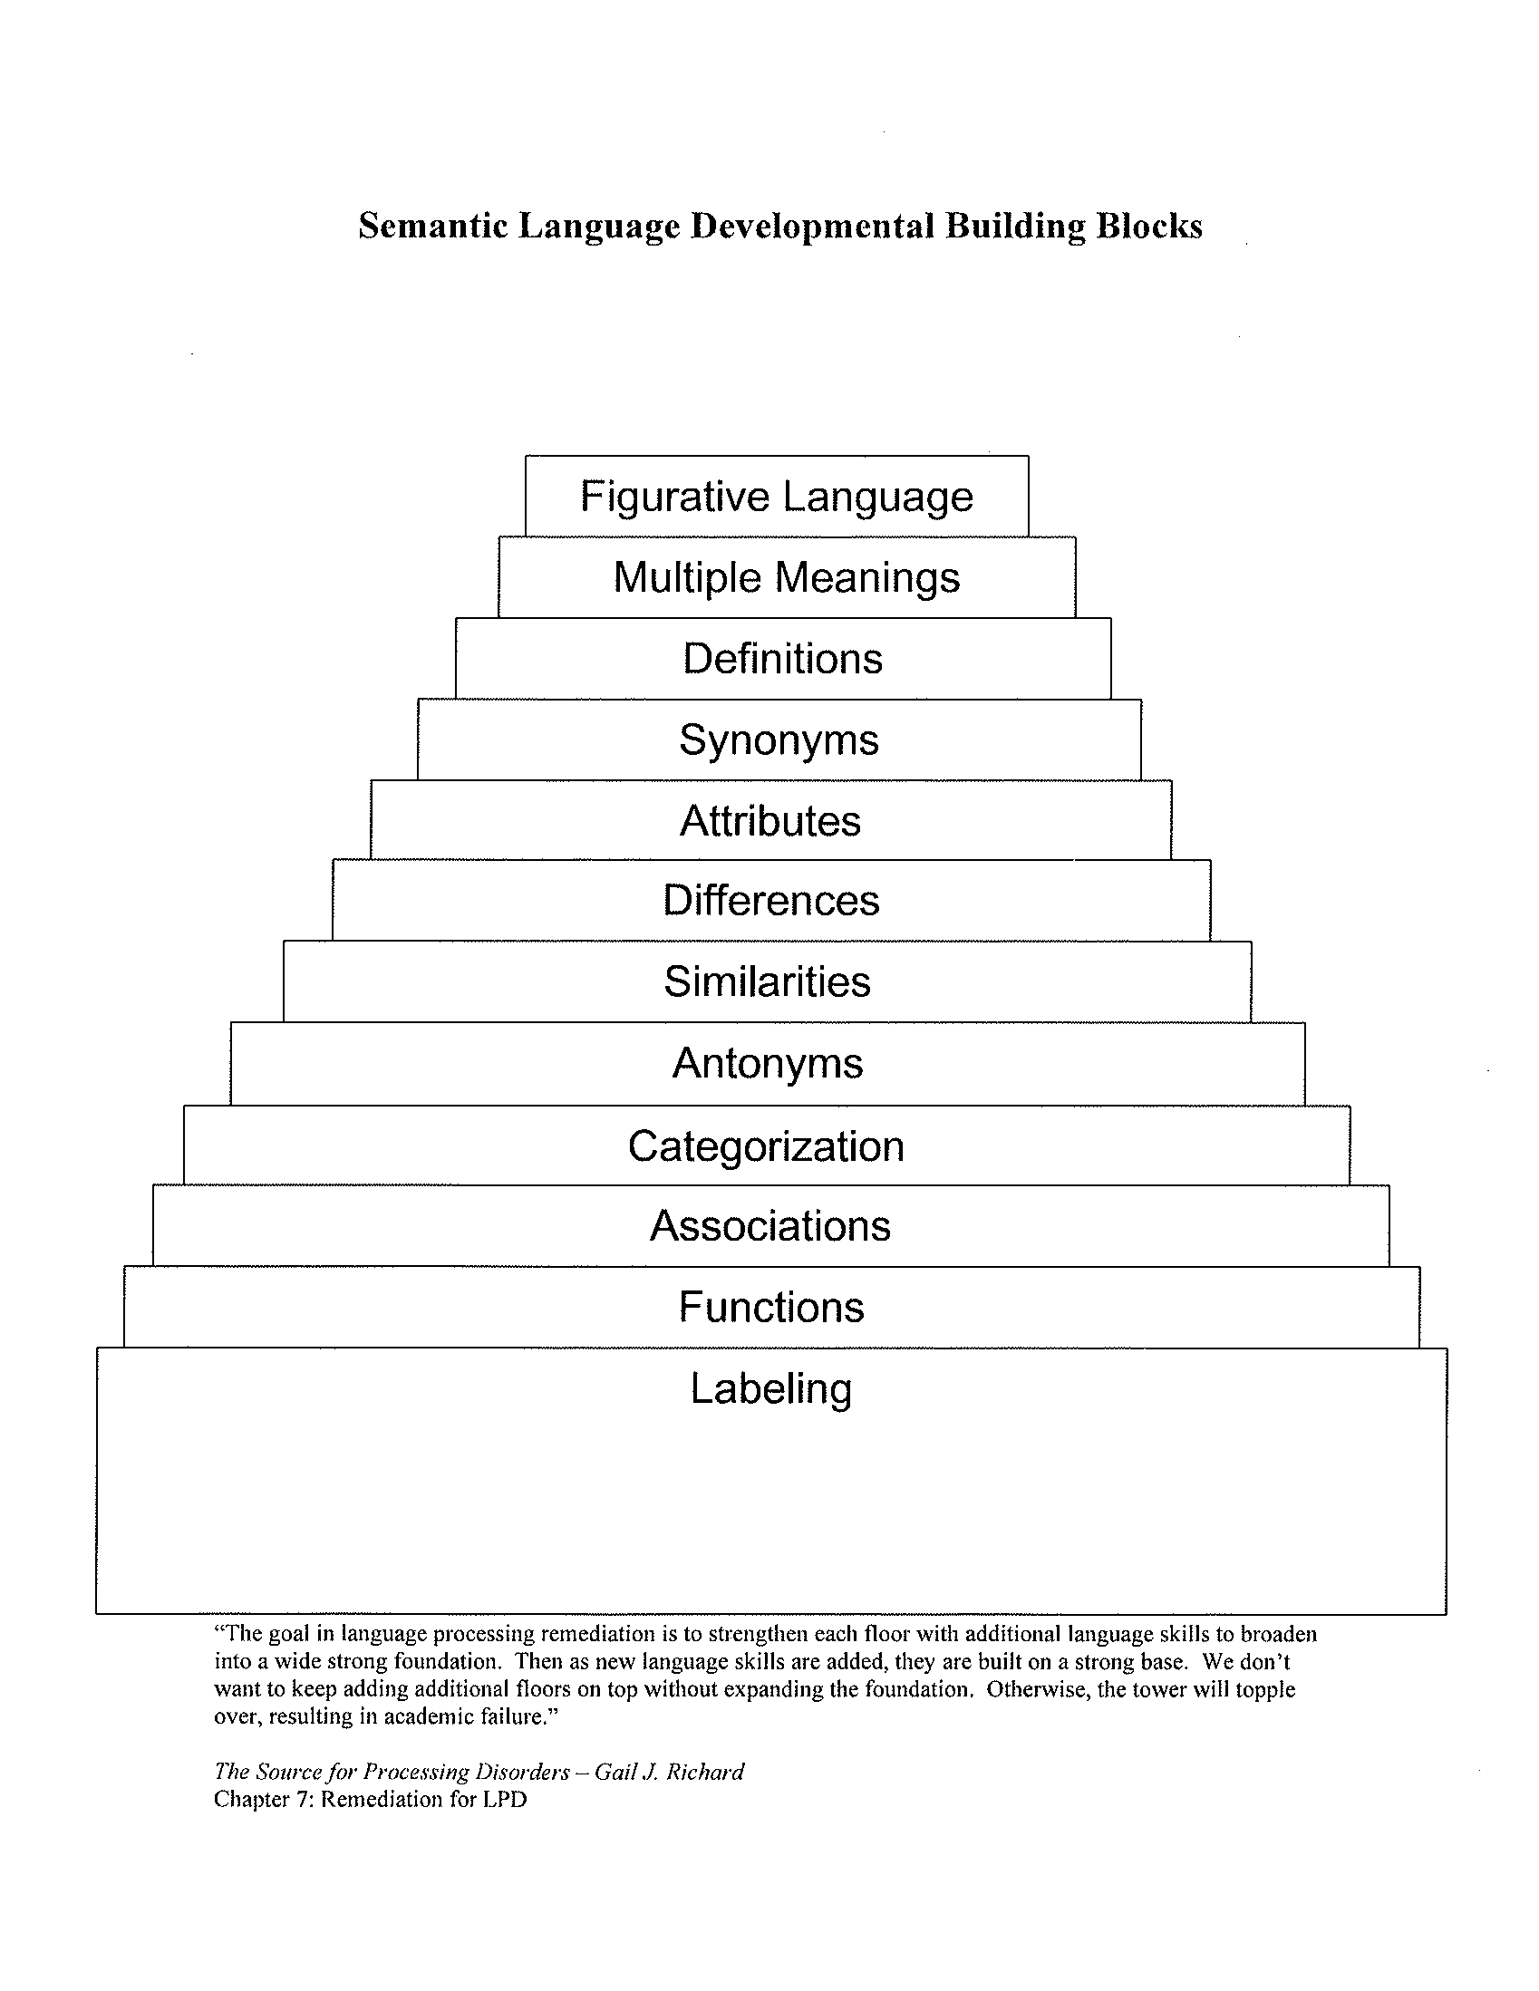
Robust Vocabulary Instruction
Leads to:
Conversational Proficiency
Academic Language Proficiency
The Source for Processing Disorders – Gail J. Richard, Chapter 7: Remediation for LPD
Notes:
Taken from the Language Processing Test (SLP test).

Slide 47
The Jenga Tower of Semantic Building
Figurative Language
Multiple Meanings
Definitions
Synonyms
Attributes
Differences
Similarities
Antonyms
With lots of gaps, there is a weak foundation and lack of stability.
Categorization
Associations
Functions
Labeling

Slide 48
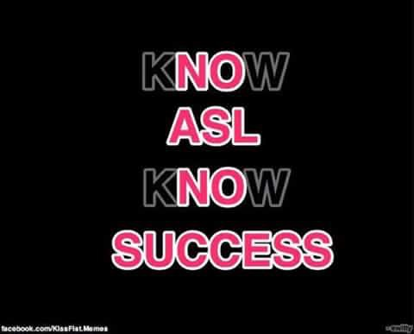
Notes:
‘Nuff said!

Slide 49
A Palette of mastery

Slide 50
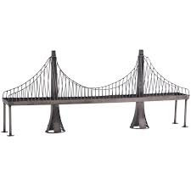
ASL AS THE BRIDGE

Slide 51
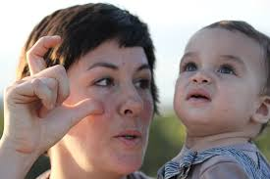
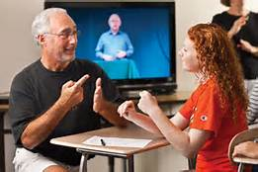
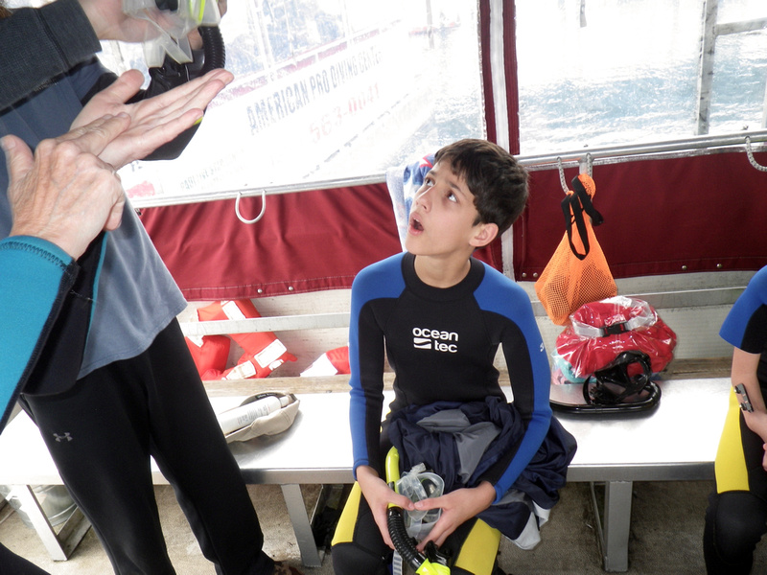
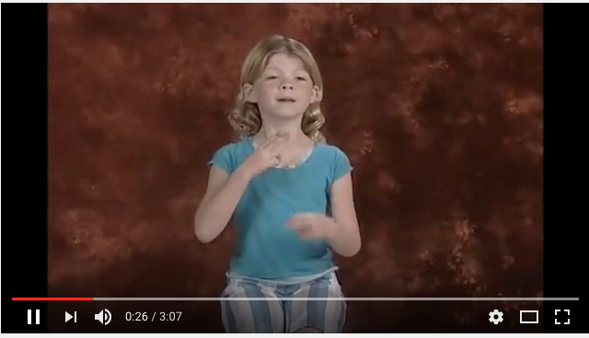
The Bridge of ASL
ASL
Attending
Viewing
Signing
Skills
Academics
Critical Thinking
Learning Strategies
Subject Knowledge
Concept Formation
Reading and Writing Skills

Slide 52
Bilingual; Not Broken!
Fluent bilingual DHH children who are kindergarten-ready:
Are socially and emotionally healthy (Ronnberg, 2003 and Schick, 2006)
Have better conflict resolution abilities, better working memory performance, greater mental flexibility (Kushalnagar et al. 2010)
Have much higher vocabulary bases (Klatter-Folmer et al. 2006; Fish and Morford, 2012)
Delays the onset of dementia (Bialystok et al. 2004, 2007)

Slide 53
Frederick Douglass
“It is easier to build strong children than to repair broken men.”
Notes:
Fluent bilingual DHH children who are kindergarten-ready:
Do not rely on governmental assistance
Have no language delays
Have higher reading scores (Chamberlain & Mayberry, 2008)
Score better on the SAT and ACT
Graduate from college or a technical program
Get good jobs, get higher paying jobs, and pay taxes
This is from the American Civil War era.
African Americans still struggle today because a group of people decided their fate for them, influencing their culture, language, and education.
Even with the successes of the Civil Rights movement, we have turmoil in Ferguson, Missouri and many other places in America.
Women in America have fought for and won many rights, but still struggle for respect and equal pay.
Native Americans have been “compensated” for the loss of their lands.
The LGBT community still struggles today with issues of marriage and even which bathrooms they are allowed to choose.
Which group is left? The Deaf Community.
Equality will happen. The question is…how fast will it happen. How hard will you fight to make that happen?
My challenge to you today is simply to BEGIN. Like Nyle, begin to make your life and the lives of others better by joining a cause that is just.

