Slide 1
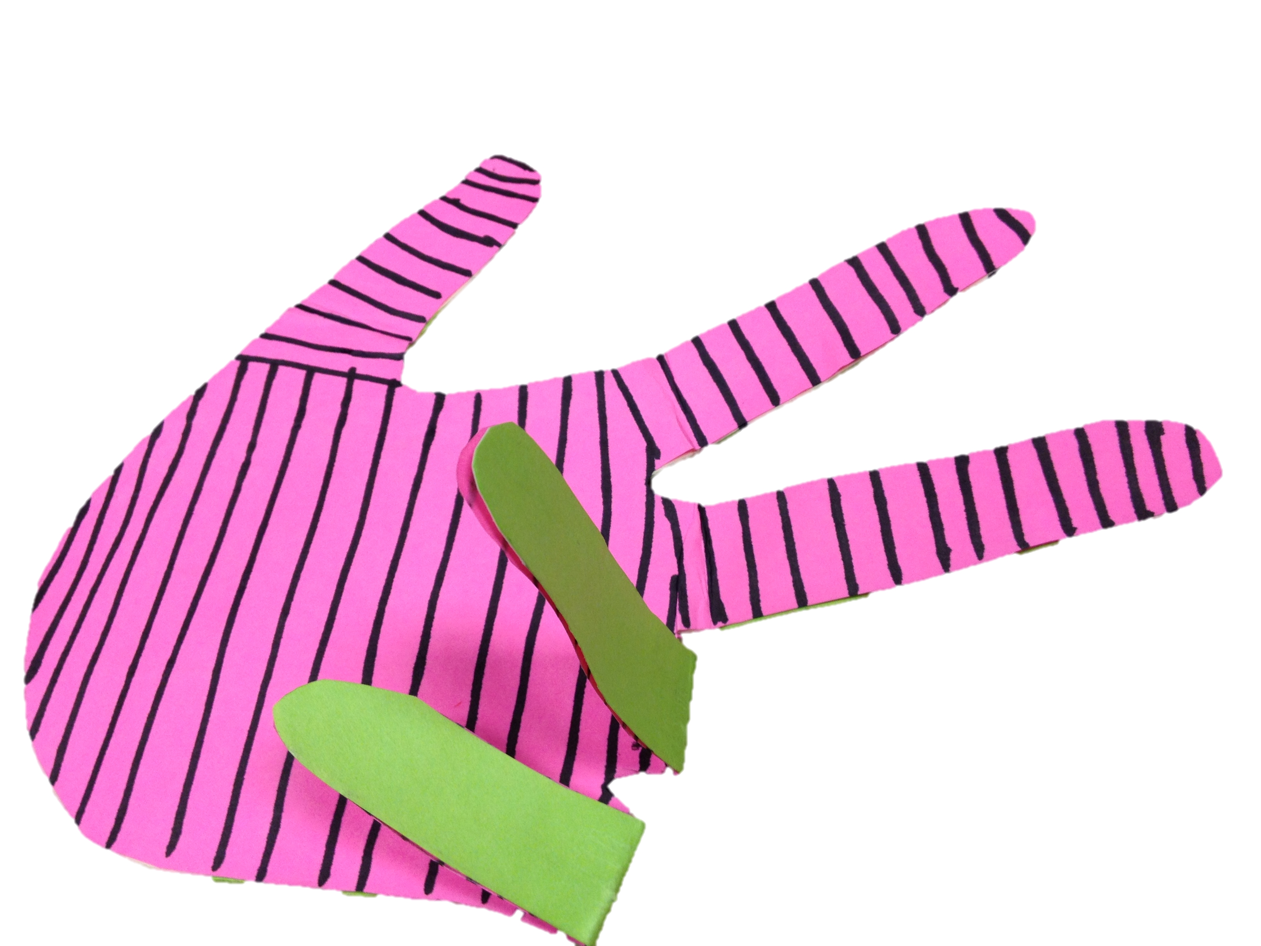
Manipulating Language
Shira Grabelsky
ASL Roundtable 2017
shira.grabelsky@nmsd.k12.nm.us
Notes:
Manipulating Language
During this interactive workshop, we will explore what it means to manipulate language both literally and figuratively. American Sign Language has been manipulated over time and in many different contexts. Teaching ASL also involves manipulating the language to enhance student acquisition, development, understanding, and internalization of the language. It takes us away from using ASL in the classroom for instruction and then resorting to a paper with English text when we ask students to create their own work. It keeps the teaching and learning process tied to the same language.
One aspect of this workshop involves creating and using tangible manipulatives as a way to teach literacy concepts as well as content-specific concepts. At the end of this, there will be a compilation of ideas from you.
Before continuing, it is ultimately the process of taking risks in the classroom to connect students to ideas, not from the basis of a deficit thinking model of ”needing” visual supports because that is the only way they learn, or “needing” concrete representations of concepts because abstractions are to difficult to access. The use of manipulatives comes from a place of “what if we were inspired by the language students use and inspired by their learning process, what would we create that celebrated this and made learning fun?”

Slide 2
sharing me with you
who i am in relation to the world, you, and my students
Notes:
It is important to think about who we are, how our knowledge systems relates to how we teach and our relationships with students. Knowing our own self and where that comes from helps in the process of recognizing how and what students learn what they do and using that as a starting point.

Slide 3
Notes:
What inspires me is the language itself, how the language is structured and expressed, and is ephemeral, unless it is video-recorded. This pitcher is an imprint of an idea that my aunt, a potter had. The manipulatives I will discuss are an imprint of an idea that could otherwise disappear. Next, I will show my Aunt Leah’s artist statement, which contains words and phases that I relate to as I approach the making of and use of manipulatives.

Slide 4
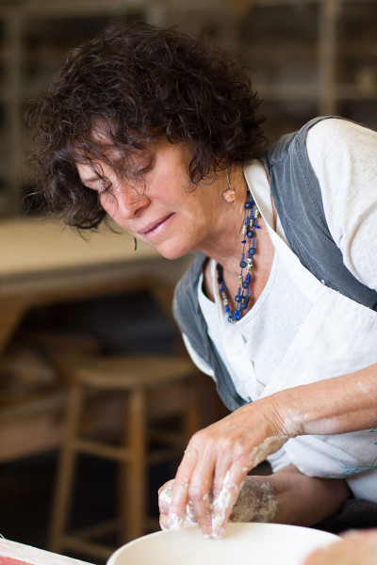
I have taken great inspiration from the natural world. From the lush swamps of Baton Rouge to the high peaks of the Blue Ridge Mountains, my porcelain forms and surface treatments are informed by the abundance and beauty of my surroundings. An equal partner in my creative interest is found amidst 18th and 19th Century...My imagination comes to life at the confluence of this historical foundation and my contemporary observations, resulting in elegant, whimsical, visually appealing, functional ceramics.

Slide 5
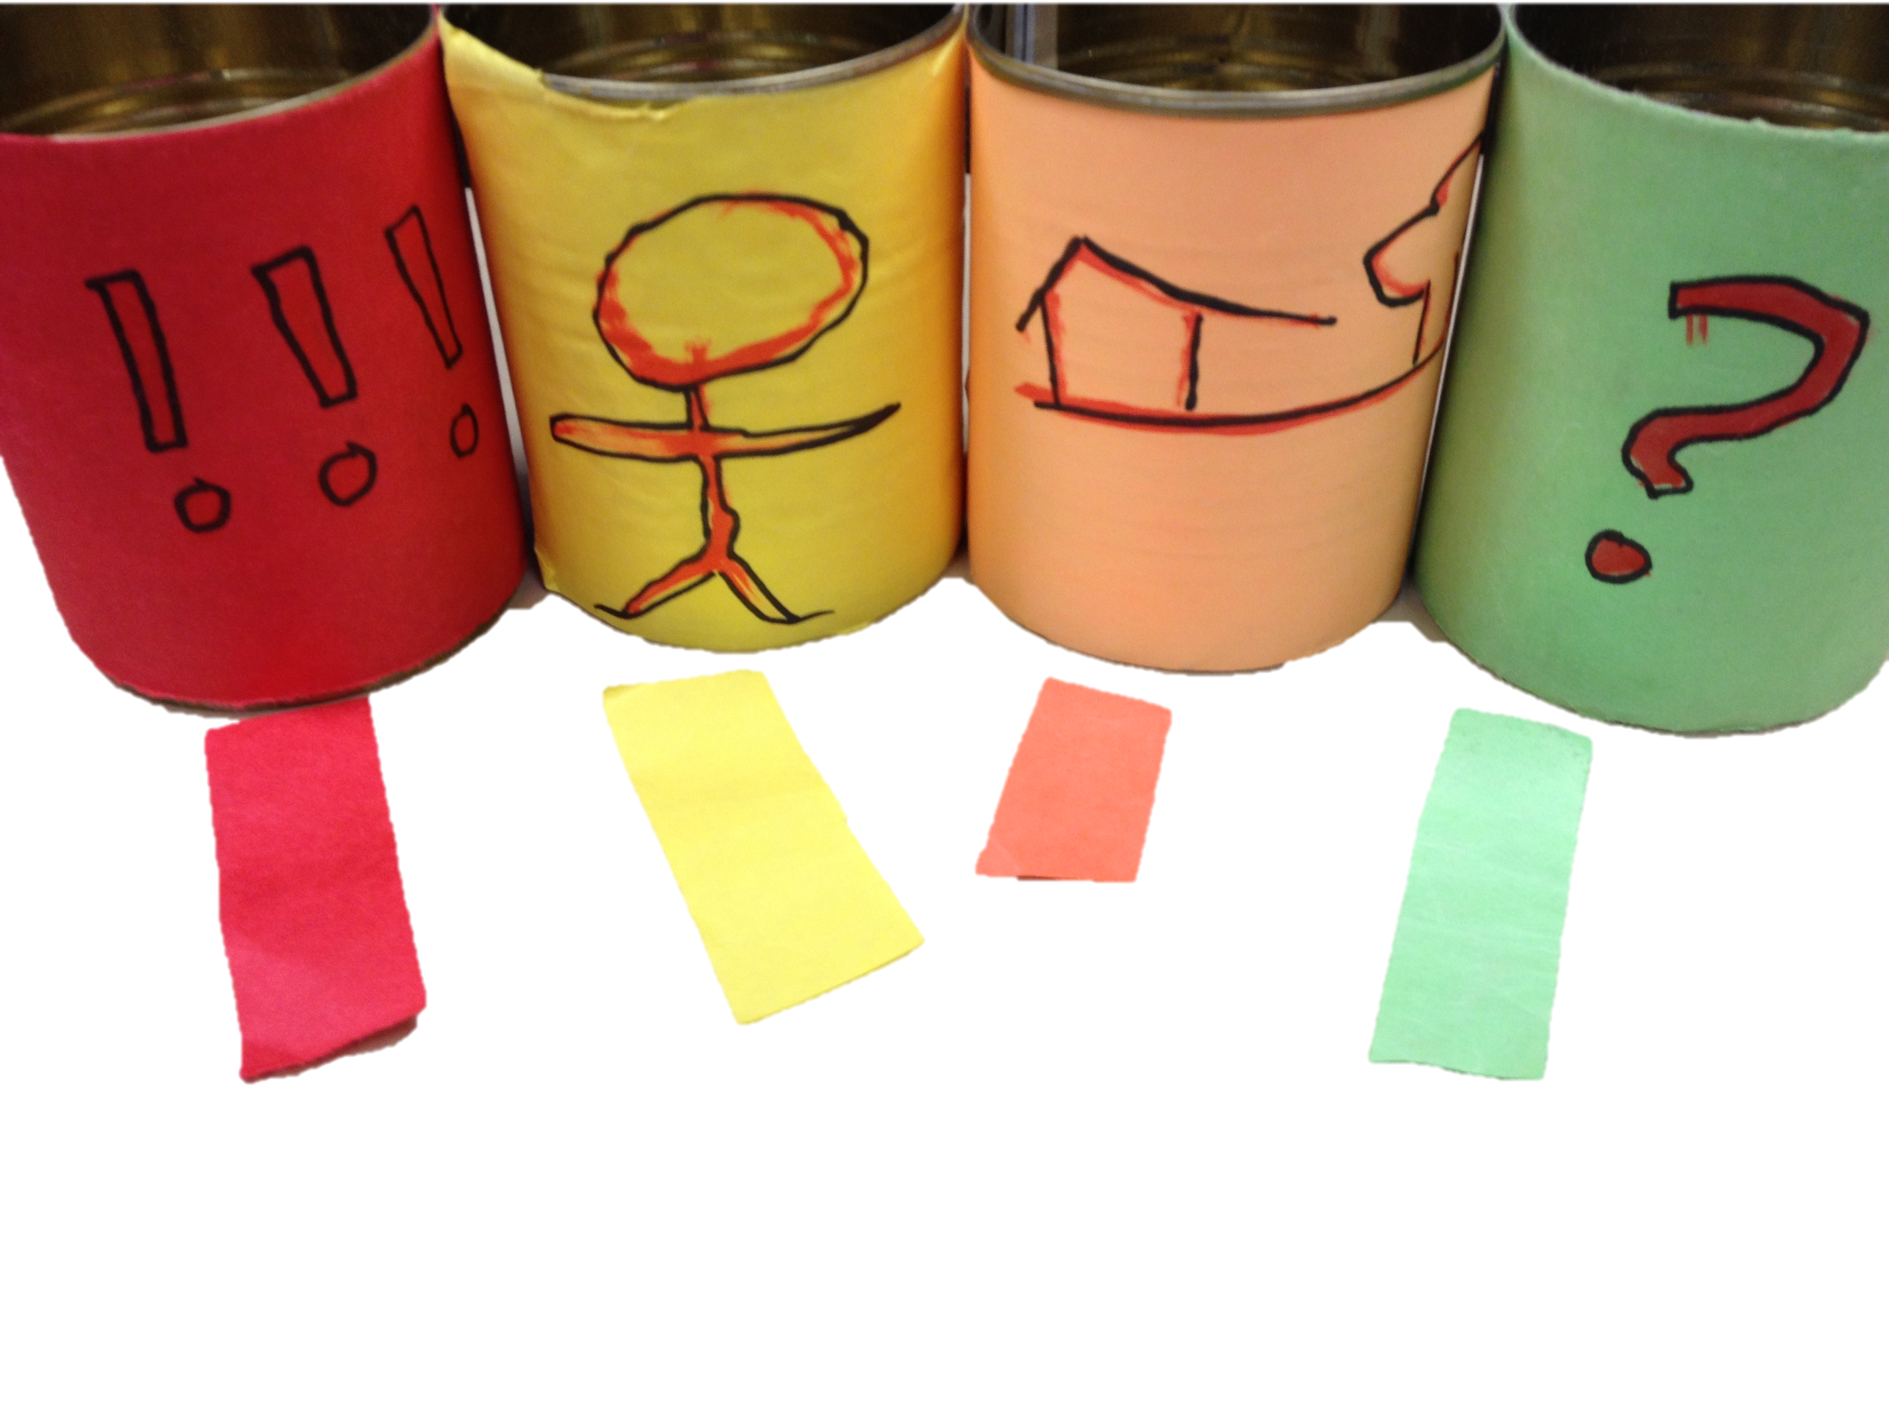
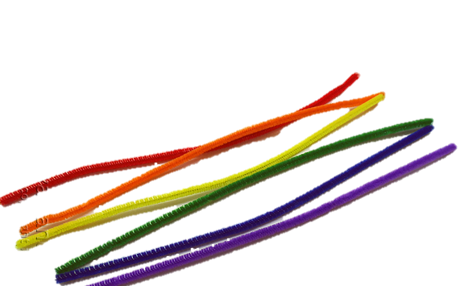
Notes:
Story elements. The cans are the “pillars” of a good story: from a western education point of view. The red, orange, yellow and green pipe cleaners are woven together and represent the weaving of these four elements: characters, setting, what happened, why that happened/what happened next/resolution.

Slide 6
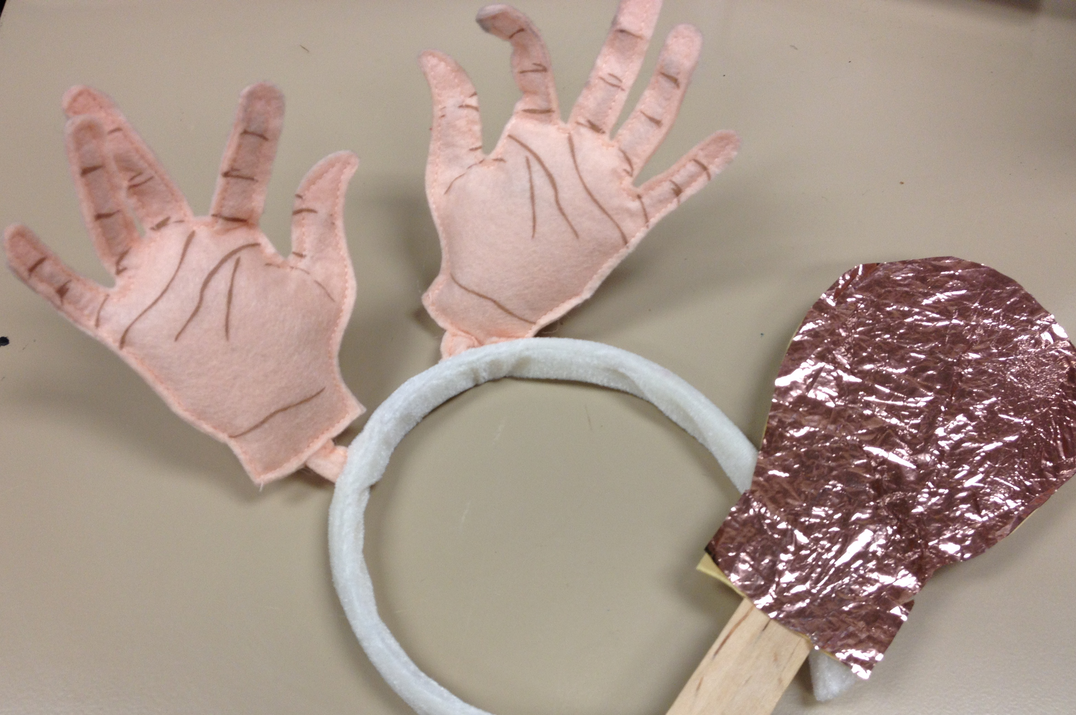
Notes:
Representations of the concept of “idea”

Slide 7
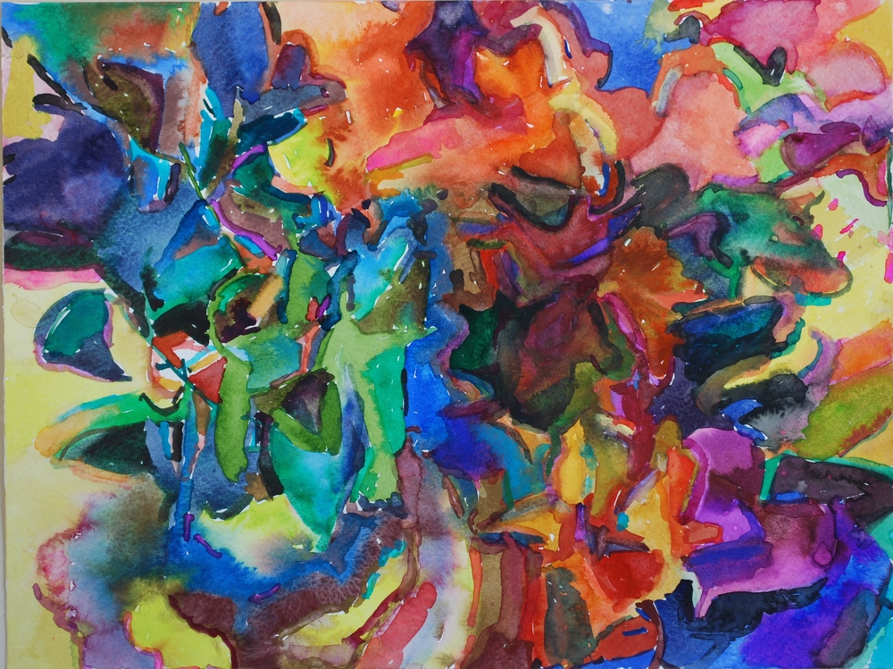
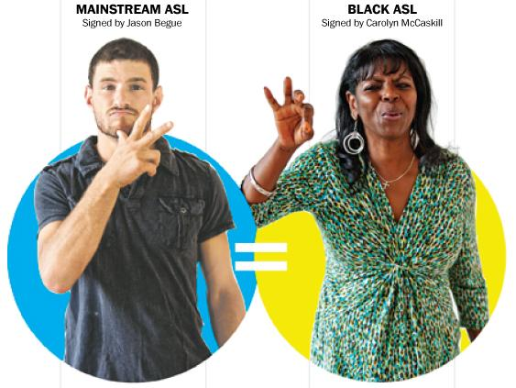
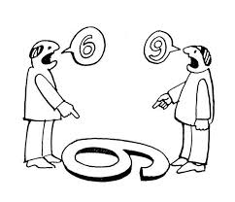
origins
language origins
teacher origins
learner origins
Notes:
Where we start in the process of making manipulatives can start from three, and probably more, points of origin.
Language origins: what does the language look like, what does it inform us? Both explicitly and implicitly.
Learner origins: probably the most important: what do our students’ ways of learning, belief systems, values tell us about how they approach new material, both language and content-based?
Teacher origins: What are our own ideas of what we are to teach and how we are to teach? Why do we have these ideas and how do they dovetail with our students’ ways of learning?
https://thesocietypages.org/socimages/2012/10/08/black-and-white-vernacular-in-american-sign-language/
http://www.aaronswindle.com/ocstzy6i0uu9ar69r69kvuyxgaclxv
http://www.ibo.org/contentassets/71f2f66b529f48a8a61223070887373a/involving-students-in-curriculum-evaluation---carla-marshall.pdf

Slide 8
Language Manipulatives
ASL
Content Area
Print Language
Communication of Information
Syntax
Morphemic or Lexical Relationships
Domain-specific concepts
Communication of Information
Syntax
Domain-specific concepts
Communication of Information
Syntax
Morphemic or Lexical Relationships
Domain-specific concepts
What do you notice?

Slide 9
Light Saber – Big Signing
Notes:
Mini-lesson on “signing space”

Slide 10
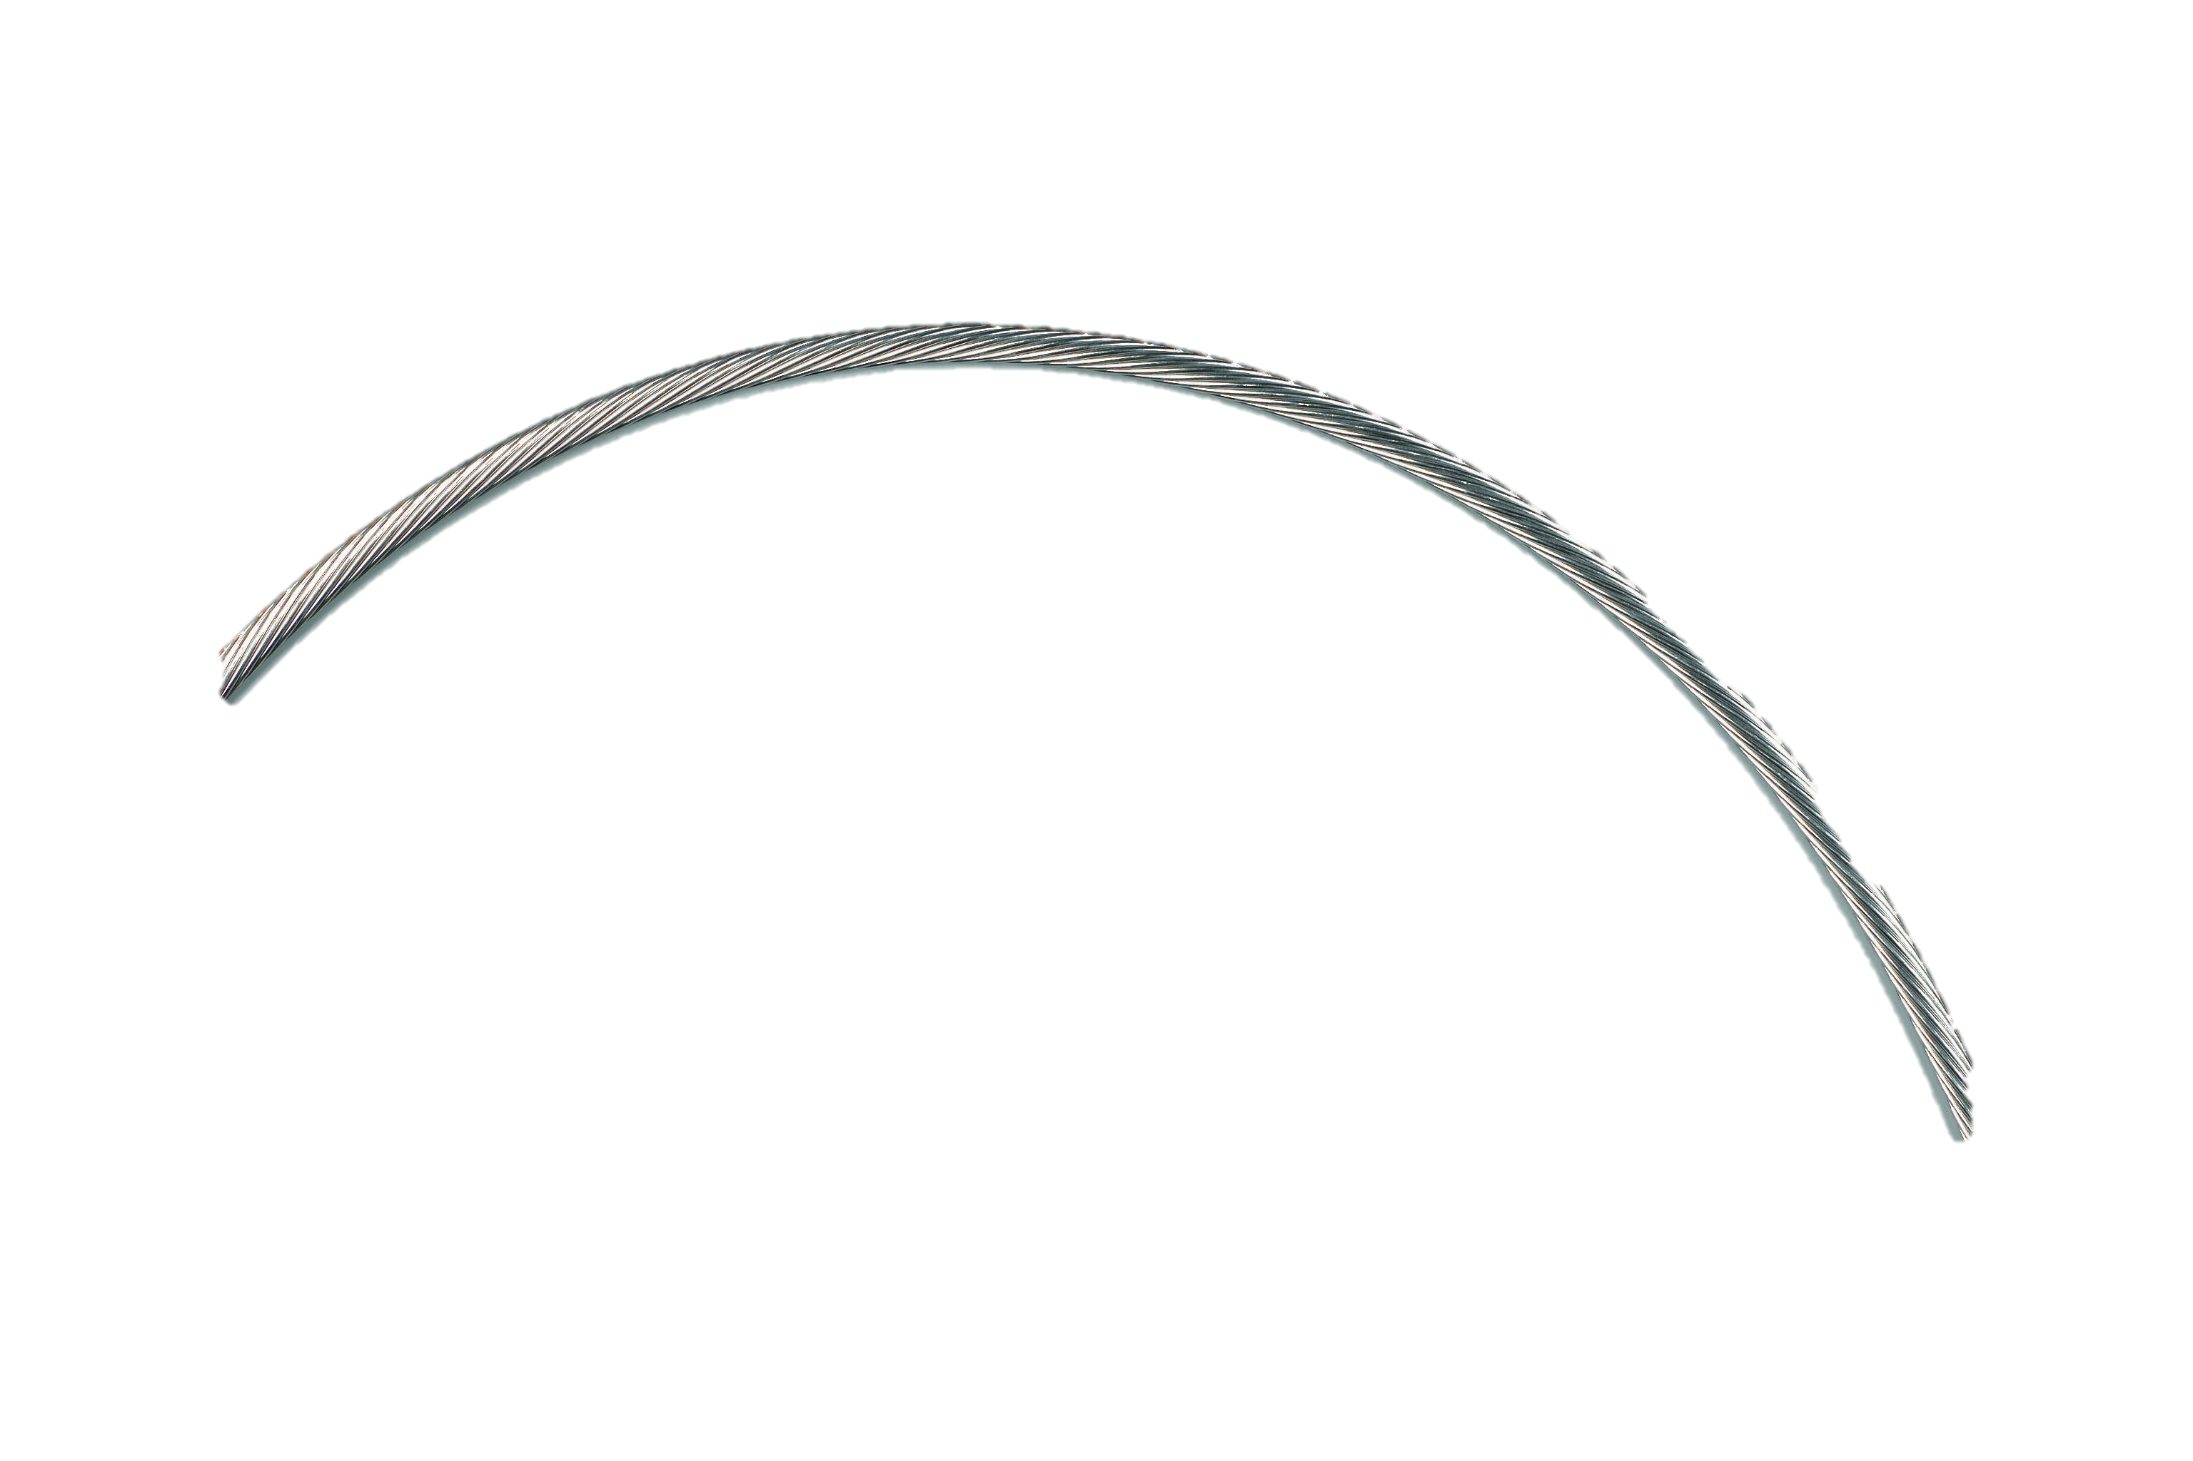
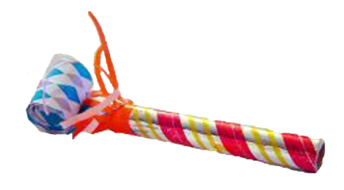
4 + 7 = 7 + 4
7
4

Slide 11
Group Work & Sharing
Notes:
This visual manipulative can be adjusted to be used to discuss how to organize an essay. Play around with it because there are so many ways to organize an essay, or even a narrative!

Slide 12
Group Work
contributions table open too!
By Lunchtime
Think about YOUR students; what language skills are you working on or will work on?
Create a personal mental list of 3-5 of these language skills
Share that list with your table group
As a group, pick a language skill to be your focus as you develop a prototype of that manipulative
Use materials at the main art table to create your manipulative
Sharing
Gallery
See next slides for photograph and click on links for descriptions of the ideas we’ve come up with!
Notes:
Set up one ”ideas sheet” for list of manipulative ideas

Slide 13
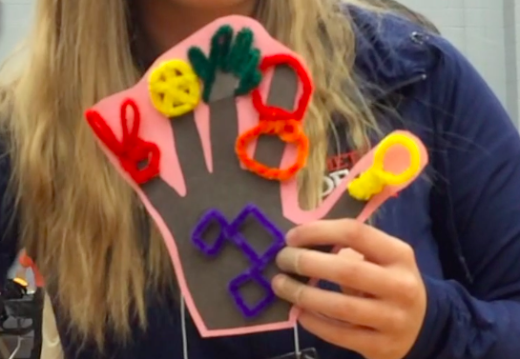
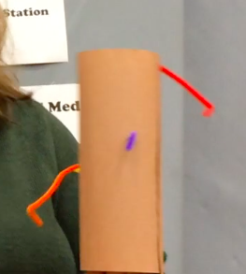
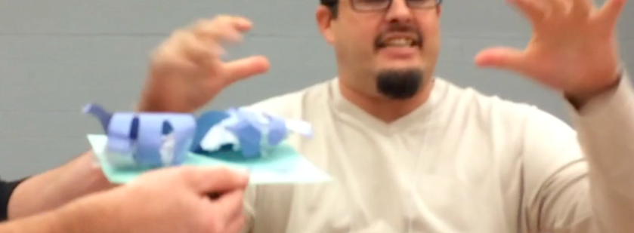
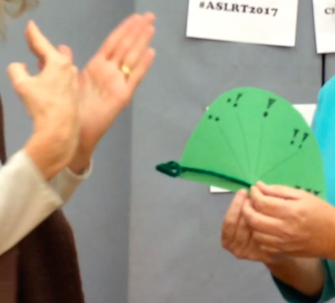
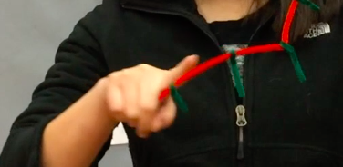
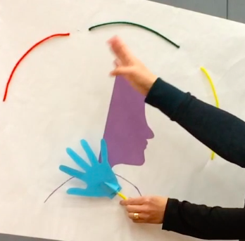
Classifiers and Movement
Ideas - Details
ASL 6+1 Traits Guide
Storyline - Details
Degrees of Adjectives
Time- Past, Present, and Future

Slide 14
in closing
thoughts / questions / ideas

